Slide 1

Natural Language Processing Course Manipulating Strings
Ivo Bernardo – Udemy Course

Slide 2


Strings Overview
We can access our string in Python using this name from here on
example_string = ‘europe’
Accessing the first letter on index 0
Accessing the first 3 letters
Important property: Strings are immutable!

Slide 3


Strings Overview – Combining Strings
eu_1= ‘european’
eu_2 = ‘union’
Combining two or more strings using +
Replicating the word european 4 times

Slide 4
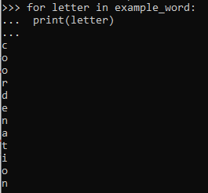
Strings Overview – Iterating on Strings
example_word = ‘coordenation’
Iterating through each letter of the word and printing it

Slide 5
Strings Overview – Important Methods
len() – extracts length of sentence (or any other Python object)
.upper()
.lower()
.capitalize()
str() – conversion method
isalpha() – testing method
strip() – strips leading blanks
split() – splits sentence by a specific character
.join() – usually applied on lists to concatenate elements
.count() – counts specific elements
.replace() – replaces a specific part of a string
.find() – finds specific element in sentence
Casing methods

